Slide 1
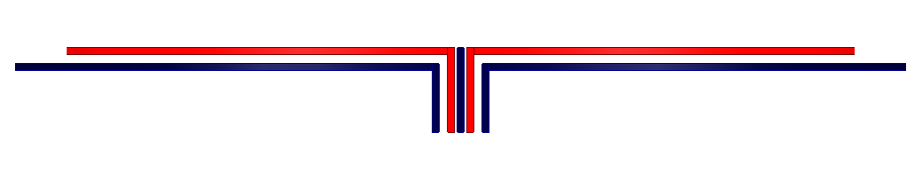
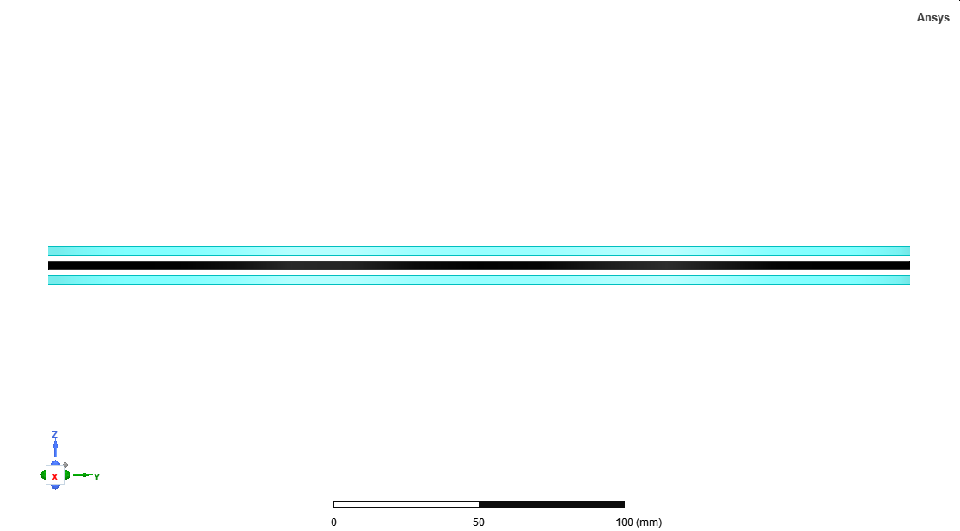
Tx1
Ferrite
Tx2
Ferrite
Ferrite
MSR
(a)
Ferrite
MSR
(b)

Slide 2
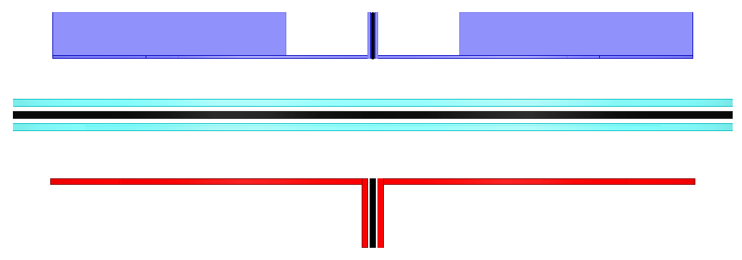
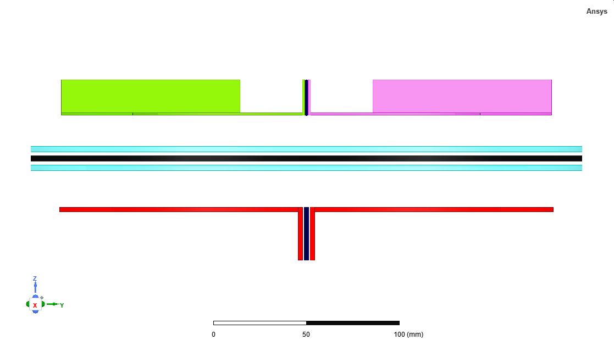
Ferrite
Rx1
Rx2
MSR
Ferrite
MSR
Tx1
Bent end-windings
Tx2
Ferrite

